Slide 1

Reusable Workflows
Introduction to reusable workflows
Why use reusable workflows?
Defining and Publishing reusable workflow
Importing a reusable workflow
Specifying input values for reusable workflows
Sharing reusable workflows across teams and organizations
Best practices for reusable workflows
Common use cases for reusable workflows
Limitations of reusable workflows
Advanced features of reusable workflows
Conclusion and next steps
Notes:
Reusable workflows in GitHub Actions are like a set of Lego blocks that you can use to build different things, depending on what you need 🧱. Here are some common ways that people use reusable workflows:
🚀 CI/CD pipelines: If you're building and deploying software, you can use reusable workflows to automate the process of building, testing, and deploying your code. This makes it easier to deploy your code quickly and with fewer errors.
💻 Automated testing: You can also use reusable workflows for automated testing. By creating a reusable workflow for running tests, you can save time and effort by avoiding the need to set up testing from scratch for each project.
🔍 Static code analysis: Reusable workflows can also be used for static code analysis. By creating a workflow for analyzing code, you can catch potential issues before they become bigger problems.
📖 Documentation: If you need to generate documentation or other project artifacts, you can use reusable workflows to automate the process. This ensures that your documentation is generated consistently and saves you time.
🎨 Code formatting: Reusable workflows can also help with code formatting. By creating a workflow that enforces consistent code formatting, you can improve the readability and maintainability of your code.
By using reusable workflows, you can save time, reduce duplication of effort, and make your workflows more consistent. This can ultimately help you deliver better results for your projects or organization 🎉.

Slide 2

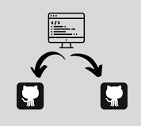

Introduction
Notes:
Think of reusable workflows in GitHub Actions like a shared toolbox.
Imagine you're part of a big organization with lots of different departments, each with their own tools and processes for getting things done.
Sometimes, different departments might use similar tools and processes, but with slightly different settings.
Now, instead of each department creating their own custom toolbox,
Imagine there's a central department that maintains a set of common tools and processes.
This central department can then share these tools and processes with the other departments as needed.
Reusable workflows in GitHub Actions work in a similar way.
They're like a central toolbox that defines a common set of tools and processes that can be used by multiple repositories.
Instead of duplicating the same workflow code across different repositories, you can define it once in a central location and then import it as needed.
This helps to reduce duplication and make it easier to maintain the workflows across multiple repositories.
Plus, any changes you make to the central toolbox are automatically shared with all the repositories that use it.

Slide 3
Why use reusable workflows?
Simplify your workflow code
Improve maintainability
Reduce duplication
Facilitate collaboration
Save time and effort
Notes:
Reusable workflows in GitHub Actions are like having a superpower that lets you simplify your workflow code, improve maintainability, reduce duplication, collaborate better, and save time and effort.Here are some reasons why you might want to use reusable workflows:
Simplify your workflow code: By defining a reusable workflow in a central location, you can avoid duplicating the same code across multiple repositories. This can help to simplify your workflow code and make it easier to maintain.
Improve maintainability: Reusable workflows can help to improve maintainability across your repositories. Any changes you make to the central workflow are automatically shared with all the repositories that use it, reducing the amount of manual updates you need to make.
Reduce duplication: Instead of recreating the same workflow code in multiple repositories, you can define a reusable workflow once and then import it as needed. This can help to reduce duplication and ensure consistency across your projects.
Facilitate collaboration: Reusable workflows can help to facilitate collaboration across your team or organization. By defining a set of common tools and processes, you can ensure that everyone is working from the same playbook.
Save time and effort: By using a reusable workflow, you can save time and effort in creating and maintaining your workflows. This can free up time for other important tasks, such as developing new features or fixing bugs.
Overall, reusable workflows can be a real game-changer for developers and DevOps engineers working on projects with multiple repositories. They help you work smarter, not harder, and make it easier to achieve your goals.

Slide 4
Defining and Publishing reusable workflow
Create a YAML file
Name your workflow
Specify your inputs
Define reusable jobs
Save and publish
Notes:
Defining and publishing a reusable workflow in GitHub Actions involves:
Creating a YAML file: Define a YAML file that includes the steps and configurations for your reusable workflow.
Naming your workflow: Give your reusable workflow a name that will help identify it across multiple repositories.
Specifying your inputs: Define any required inputs or parameters for your reusable workflow, such as which branches to build or which environment to deploy to.
Defining reusable jobs: Define reusable jobs within your workflow that can be called by other workflows. Reusable jobs can be used to group related steps and configurations together, making it easier to organize and maintain your workflow.
Saving and publishing: Save your YAML file and publish it as a reusable workflow that can be imported into multiple repositories.

Slide 5
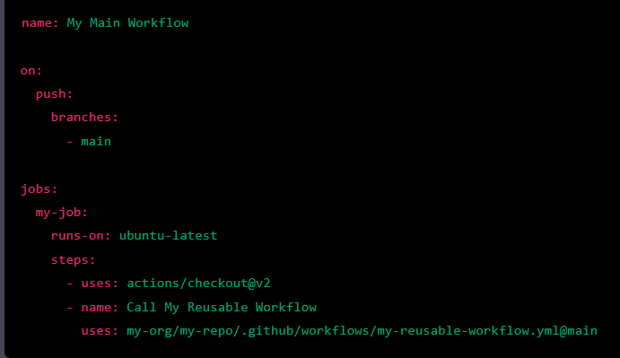
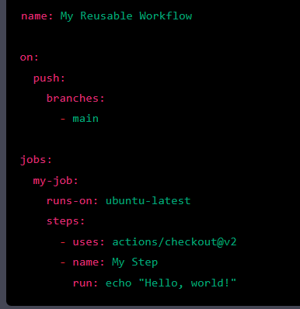
Importing Reusable Workflows
Notes:
In this example, the Call My Reusable Workflow step uses the workflow_call action to reference the my-reusable-workflow.yml file in the my-org/my-repo repository. The @main part specifies the branch to use. When the workflow is run, the steps in the reusable workflow will be executed as part of the job.

Slide 6
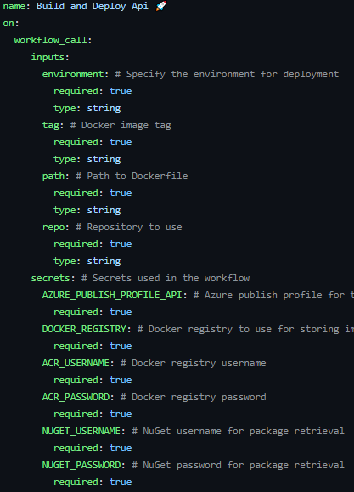
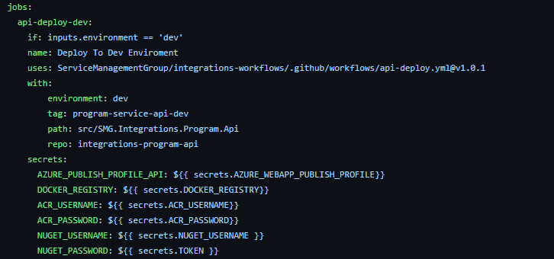

Slide 7
Sharing reusable workflows across teams and organizations
🌎 Use public repositories:
🔒 Use private repositories
👥 Use organization-level workflows
🌐 Use external workflows:
📝 Use workflow templates:
Notes:
Sharing reusable workflows across teams and organizations is a great way to standardize processes and collaborate more effectively 🤝. GitHub Actions provides various ways to share reusable workflows, depending on your needs and preferences 🤔.
Here are a few ways you can share your reusable workflows:
🌎 Use public repositories: You can make your reusable workflow public by putting it in a GitHub repository. Anyone with the repository URL can access and use the workflow. This is a great option if you want to share your workflow with a lot of people or contribute to an open-source project.
🔒 Use private repositories: If you want to share a reusable workflow with a specific group of people, you can create a private repository and give access to those people. Private repositories are a good option if you need to share sensitive or proprietary workflows or want to work on a project with a limited group of people.
👥 Use organization-level workflows: If you have multiple repositories in an organization that need to use the same workflow, you can define the workflow at the organization level. This allows you to define the workflow once and reuse it across multiple repositories within the organization.
🌐 Use external workflows: If you want to use a reusable workflow from another organization or repository, you can reference the workflow using the uses keyword in your workflow file. This allows you to use the workflow without copying or modifying it.
📝 Use workflow templates: GitHub Actions also provides a feature called "workflow templates," which allow you to define a set of reusable workflows and make them available to other repositories and organizations. Workflow templates are a good option if you have a set of workflows that you want to share across multiple projects or organizations.
By sharing reusable workflows across teams and organizations, you can reduce duplication of effort, improve consistency, and make it easier to collaborate on projects 💪. With the flexibility and customization options provided by GitHub Actions, you can create workflows that meet the specific needs of your team or organization 🚀.

Slide 8
Best Practices
🧩 Design for flexibility:
📝 Document clearly:
💻 Use input parameters:
👨‍💻 Test thoroughly
📅 Version control:
🤝 Share with others:
💪 Collaborate and learn:
Notes:
Creating reusable workflows in GitHub Actions can be a powerful way to simplify and standardize your workflows, but it's important to follow best practices to ensure their effectiveness and ease of use 🚀.
Here are some tips to keep in mind:
🧩 Design for flexibility: When creating a reusable workflow, try to make it flexible and adaptable to different use cases, so it can be reused across multiple repositories or organizations. Avoid hard-coding values or assumptions that may not apply in all contexts.
📝 Document clearly: Make sure to document your reusable workflows with clear descriptions, examples, and instructions for use. This can help others understand how to use your workflows and troubleshoot issues that may arise.
💻 Use input parameters: Use input parameters in your reusable workflows to make them more flexible and customizable for different use cases. By allowing users to customize inputs, you can create workflows that can be reused in various contexts.
👨‍💻 Test thoroughly: Before sharing your reusable workflows with others, make sure to test them thoroughly to identify and fix any issues that may impact their performance. This can help ensure their reliability and effectiveness.
📅 Version control: Use version control to manage changes to your reusable workflows over time. This can help to ensure that changes are made in a controlled and predictable way, and that older versions of the workflow can still be used if needed.
🤝 Share with others: Share your reusable workflows with others in your organization or in the broader community, so they can benefit from your work and improve it even further.
💪 Collaborate and learn: Collaborate with others to improve and refine your reusable workflows over time. Solicit feedback from other users and incorporate their suggestions and contributions into your workflows. This can help you learn from others and improve your workflows together.
By following these tips, you can create and use reusable workflows that are adaptable, reliable, and easy to use. This can help you streamline your workflows, improve collaboration, and ultimately achieve better results for your projects 🚀.

Slide 9
Common Use Cases
🚀 CI/CD pipelines:
💻 Automated testing:
🔍 Static code analysis:
📖 Documentation:
🎨 Code formatting:
Notes:
Reusable workflows in GitHub Actions are like a set of Lego blocks that you can use to build different things, depending on what you need 🧱. Here are some common ways that people use reusable workflows:
🚀 CI/CD pipelines: If you're building and deploying software, you can use reusable workflows to automate the process of building, testing, and deploying your code. This makes it easier to deploy your code quickly and with fewer errors.
💻 Automated testing: You can also use reusable workflows for automated testing. By creating a reusable workflow for running tests, you can save time and effort by avoiding the need to set up testing from scratch for each project.
🔍 Static code analysis: Reusable workflows can also be used for static code analysis. By creating a workflow for analyzing code, you can catch potential issues before they become bigger problems.
📖 Documentation: If you need to generate documentation or other project artifacts, you can use reusable workflows to automate the process. This ensures that your documentation is generated consistently and saves you time.
🎨 Code formatting: Reusable workflows can also help with code formatting. By creating a workflow that enforces consistent code formatting, you can improve the readability and maintainability of your code.
By using reusable workflows, you can save time, reduce duplication of effort, and make your workflows more consistent. This can ultimately help you deliver better results for your projects or organization 🎉.

Slide 10
Limitations
🤷‍♀️ Limited customization:
📦 Dependency management:
🔄 Versioning issues:
🌐 Limited scope:
🔐 Security concerns:
Notes:
Reusable workflows are like a magic wand in GitHub Actions that can make your life easier, but like any tool, they have their limitations. Here are some things to keep in mind:
🤷‍♀️ Limited customization: You can't always have your cake and eat it too. Reusable workflows are designed to work across different repositories, so they may not be as customizable as a custom workflow.
📦 Dependency management: If your reusable workflow relies on other things like specific software versions or APIs, you need to make sure they're available and working properly.
🔄 Versioning issues: If you update a reusable workflow, you may need to be careful that it doesn't break existing workflows that depend on the old version.
🌐 Limited scope: Reusable workflows are great within your own organization, but they may not be as useful if you need to work outside of it.
🔐 Security concerns: If your workflow relies on sensitive information, you need to be extra careful that it doesn't get exposed accidentally.
Despite these limitations, reusable workflows are still super useful in simplifying and standardizing your workflows, so keep using them! 🚀

Slide 11
Advanced Features
🤖 Conditional logic:
🌍 Matrix builds:
⏩ Parallelism
📦 Caching
🖐️ Manual triggers:
Notes:
So, you're already familiar with reusable workflows in GitHub Actions, but did you know that there are some advanced features that can make them even more powerful? Let me break it down for you in plain English:
🤖 Conditional logic: With conditional logic, you can add a bit of intelligence to your reusable workflow. You can use an if statement to execute certain steps only if a specific condition is met, which can help streamline the workflow and save time.
🌍 Matrix builds: Matrix builds allow you to run your reusable workflow across multiple configurations, which is especially useful for testing code across different platforms or environments. This can help ensure that your code works seamlessly across different setups.
⏩ Parallelism: Parallelism is a fancy word for running multiple steps of a reusable workflow at the same time. By using parallelism, you can speed up the execution of the workflow and get your results faster.
📦 Caching: Caching is like having a shortcut to commonly used dependencies or files. By caching frequently used items, you can avoid the time-consuming process of downloading or generating files repeatedly, which can significantly improve the performance of your workflow.
🖐️ Manual triggers: Sometimes, you need to take control of the workflow yourself. With manual triggers, you can set up your reusable workflow to be triggered manually, which is useful for workflows that require user input or approval before executing.
By using these advanced features, you can further customize and optimize your reusable workflows to meet your specific needs. So, go ahead and give them a try! You might be surprised at how much time and effort you can save. 🚀

Slide 12

Congratulations
Notes:
Congratulations! You've learned all about reusable workflows in GitHub Actions and how they can help you streamline and standardize your workflows.
To recap, reusable workflows are a set of workflow steps that can be used across multiple repositories, making it easy to maintain consistency and reduce duplication. You can define, publish, and import reusable workflows, and use advanced features like conditional logic, matrix builds, parallelism, caching, and manual triggers to further enhance their functionality.
If you haven't already, I encourage you to try out reusable workflows in your own projects. Start by identifying workflows that could benefit from being standardized across multiple repositories, and then define and publish them as reusable workflows. You can also explore the many existing reusable workflows available in the GitHub Actions Marketplace.
Remember to keep in mind the limitations and best practices for reusable workflows, and to always test and iterate on your workflows to ensure they're working as expected.
With reusable workflows in GitHub Actions, you can simplify and standardize your workflows, save time and effort, and ultimately, make your development process more efficient and effective. So, go ahead and give it a shot! 🚀

